Slide 1
19CSE202 Database Management Systems Functional Dependency Theory
Slides Courtesy : Abraham Silberschatz, Henry F Korth, S. Sudarshan

Slide 2
Closure of a set of FDs
Clouse set of attributes
Canonical Cover
Lossless Decomposition
Dependency Preservation

Slide 3

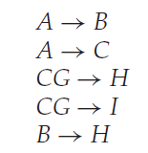

Closure of a set of FDs
Given F is a set of all FDs on a schema, we can prove that there are other fds also hold on the schema.
We can say those new fds are logically implied by the existing fds
For , for any two tuples t1 and t2
if t1[A] = t2[A] then t1[B] = t2[B]
For , for any two tuples t1 and t2
if t1[B] = t2[B] then t1[H] = t2[H]
So if t1[A] = t2[A] then t1[H] = t2[H]… so

Slide 4
F⁺
Let F is a set of FDs, then the closure of F (F⁺) is the set of all fds logically implied by F.
Armstrongs’s axioms (Three rules to find the logically implied fds)
Reflexivity Rule
Augmentation Rule
Transitivity Rule
Some Additional rules
Union Rule
Decomposition Rule
Pseudotransitivity Rule

Slide 5
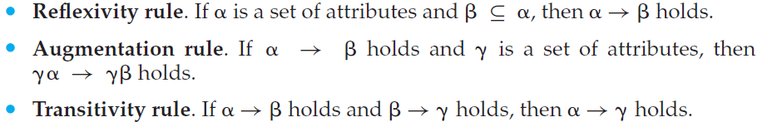
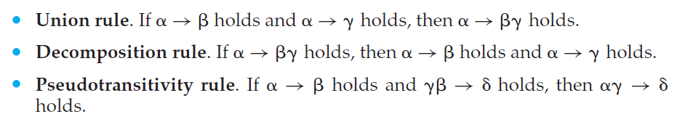

Slide 6
F =
New FDs
A → H ------ A→ B and B→ H ---- transitivity rule.
(2) CG → HI ------ CG → H and CG → I --- Union rule.
(3) AG → I ----- A→ C and CG→I --- Pseudotransitivity rule (0r)
3.1) AG→CG --- A→C --- Augmentation Rule
3.2) AG→I --- AG→ CG and CG→ I --- transitivity rule
(4) AG→ H --- A→C and CG→ H – Pseudotransitivity rule (or)
4.1) AG→CG--- A → C --- Augmentation Rule.
4.2) AG→H --- AG→CG and CG→H --- transitivity rule.

Slide 7
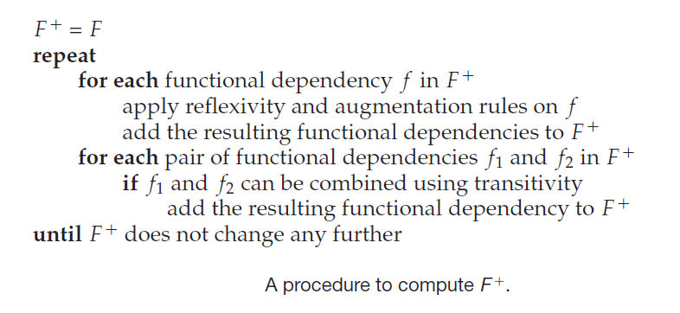
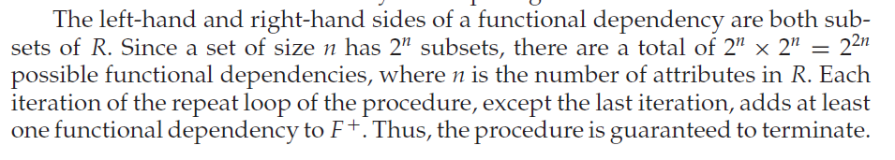

Slide 8
Closure of a set of FDs
Closure set of attributes
Canonical Cover

Slide 9
Closure set of attributes (α+)
α →β --- β is functional determined by α
To check whether α can be a key, we need to check α → (R- α) is true.
How do we do that?
Start with F.
Find F⁺
Union the RHS of all the fds where α is the LHS
Now check whether the union is (R- α).
(It is an expensive process. F⁺ may be very large)

Slide 10
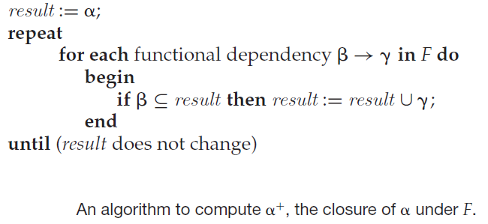
The set of all attributes which can be determined by an attribute α is called as the closure of α (denoted as α+)

Slide 11
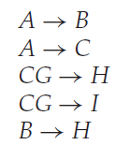
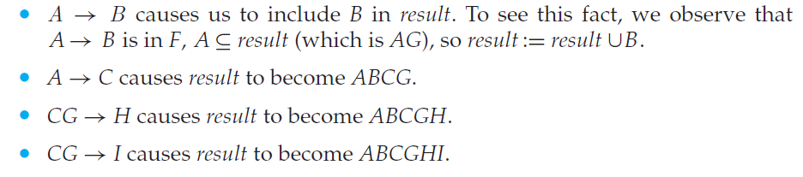
To find (AG)⁺
result = AG
Iteration (1)
Iteration (2) – No new addition.
Algorithm terminate
(AG)⁺ = ABCGHI
Ie., AG→ ABCGHI. So AG is a key to r(R)

Slide 12
Why the α+ algorithm is correct?
First step α → α is always true. So result = α
and for any subset β of result , α→β.
We start with α → result
For any fd β → γ… if β ⊆ result ….. Add γ to the result
result → β (reflexivity)
(Transitivity) α→β
α→ γ
α → result U γ

Slide 13
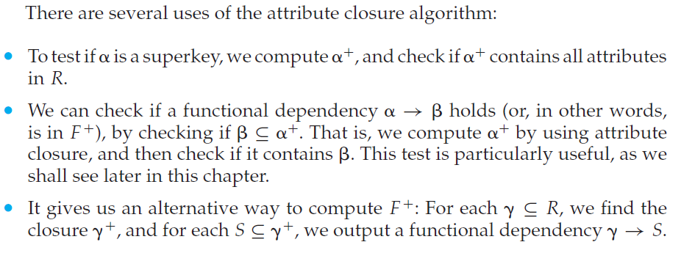

Slide 14
Additional Examples

Slide 15
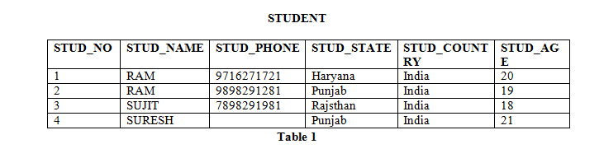
Functional Dependency
A functional dependency A->B in a relation holds if two tuples having same value of attribute A also have same value for attribute B. For Example, in relation STUDENT shown in table 1, Functional Dependencies
STUD_NO->STUD_NAME, STUD_NO->STUD_ADDR hold
but
STUD_NAME->STUD_ADDR do not hold
Functional Dependencies in a relation are dependent on the domain of the relation. Consider the STUDENT relation .
We know that STUD_NO is unique for each student. So
STUD_NO->STUD_NAME,
STUD_NO->STUD_PHONE,
STUD_NO->STUD_STATE,
STUD_NO->STUD_COUNTRY and
STUD_NO -> STUD_AGE all will be true.
Similarly, STUD_STATE->STUD_COUNTRY will be true as if two records have same STUD_STATE, they will have same STUD_COUNTRY as well.
Functional Dependency Set: Functional Dependency set or FD set of a relation is the set of all FDs present in the relation. For Example, FD set for relation STUDENT shown in table 1 is:
{STUD_NO->STUD_NAME, STUD_NO->STUD_PHONE, STUD_NO->STUD_STATE, STUD_NO->STUD_COUNTRY,
STUD_NO -> STUD_AGE, STUD_STATE-> STUD_COUNTRY }

Slide 16
Attribute Closure: Attribute closure of an attribute set can be defined as set of attributes which can be functionally determined from it.
How to find attribute closure of an attribute set? To find attribute closure of an attribute set:
Add elements of attribute set to the result set.
Recursively add elements to the result set which can be functionally determined from the elements of the result set.
Using F, attribute closure can be determined as:
(STUD_NO)+ = {STUD_NO, STUD_NAME, STUD_PHONE, STUD_STATE, STUD_COUNTRY, STUD_AGE}
(STUD_STATE)+ = {STUD_STATE, STUD_COUNTRY}
Given F = {STUD_NO->STUD_NAME, STUD_NO->STUD_PHONE, STUD_NO->STUD_STATE, STUD_NO->STUD_COUNTRY,
STUD_NO -> STUD_AGE, STUD_STATE-> STUD_COUNTRY }

Slide 17
Given R(E-ID, E-NAME, E-CITY, E-STATE)
FDs = { E-ID->E-NAME, E-ID->E-CITY, E-ID->E-STATE, E-CITY->E-STATE }
(E-ID)⁺ = {E-ID, E-NAME, E-CITY, E-STATE }
(E-NAME)⁺ = {E-NAME}
(E-CITY)⁺ = {E-CITY, E_STATE}

Slide 18
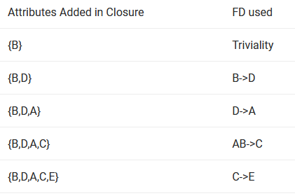
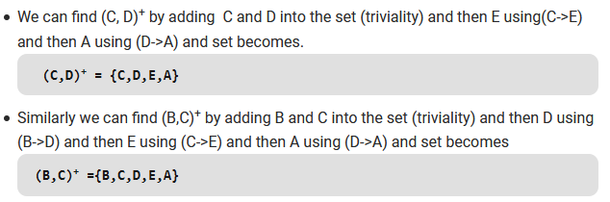
R(ABCDE) = {AB->C, B->D, C->E, D->A}
To find (B)⁺ ,

Slide 19
How to find Candidate Keys and Super Keys using Attribute Closure?
If attribute closure of an attribute set contains all attributes of relation, the attribute set will be super key of the relation.
If no subset of this attribute set can functionally determine all attributes of the relation, the set will be candidate key as well.
(STUD_NO, STUD_NAME)+ = {STUD_NO, STUD_NAME, STUD_PHONE, STUD_STATE, STUD_COUNTRY, STUD_AGE}
(STUD_NO)+ = {STUD_NO, STUD_NAME, STUD_PHONE, STUD_STATE, STUD_COUNTRY, STUD_AGE}
(STUD_NO, STUD_NAME) will be super key but not candidate key because its subset
(STUD_NO)+ is equal to all attributes of the relation. So, STUD_NO will be a candidate key.

Slide 20
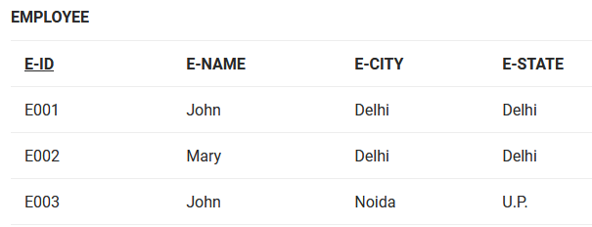
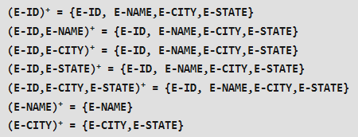
Finding Candidate Keys and Super Keys of a Relation using FD set The set of attributes
F= {E-ID->E-NAME, E-ID->E-CITY, E-ID->E-STATE, E-CITY->E-STATE}
Let us calculate attribute closure of different set of attributes:
As (E-ID)⁺,
(E-ID, E-NAME)⁺,
(E-ID, E-CITY)⁺,
(E-ID, E-STATE)⁺,
(E-ID, E-CITY, E-STATE)⁺
give set of all attributes of relation EMPLOYEE. So all of these are super keys of relation.
As shown above, (E-ID)⁺ is set of all attributes of relation and it is minimal. So it is the candidate key.

Slide 21
GATE Question: Consider the relation scheme R = {E, F, G, H, I, J, K, L, M, M} and the set of functional dependencies {{E, F} -> {G}, {F} -> {I, J}, {E, H} -> {K, L}, K -> {M}, L -> {N} on R. What is the key for R? (GATE-CS-2014) A. {E, F} B. {E, F, H} C. {E, F, H, K, L} D. {E}
Answer: Finding attribute closure of all given options, we get: {E,F}+ = {EFGIJ} {E,F,H}+ = {EFHGIJKLMN} {E,F,H,K,L}+ = {{EFHGIJKLMN} {E}+ = {E}
{EFH}+ and {EFHKL}+ results in set of all attributes, but EFH is minimal. So it will be candidate key.
So correct option is (B).

Slide 22
How to check whether an FD can be derived from a given FD set?
To check whether an FD A->B can be derived from an FD set F,
Find (A)+ using FD set F.
If B is subset of (A)+, then A->B is true else not true.
GATE Question: In a schema with attributes A, B, C, D and E following set of functional dependencies are given {A -> B, A -> C, CD -> E, B -> D, E -> A} Which of the following functional dependencies is NOT implied by the above set? (GATE IT 2005) (1) CD -> AC (2) BD -> CD (3) BC -> CD (4) AC -> BC
Answer: Using FD set given in question, (CD)+ = {CDEAB} which means CD -> AC also holds true. (BD)+ = {BD} which means BD -> CD can’t hold true. So this FD is no implied in FD set. So (2) is the required option. Others can be checked in the same way.

Slide 23
Prime and non-prime attributes
Attributes which are parts of any candidate key of relation are called as prime attribute, others are non-prime attributes. For Example, STUD_NO in STUDENT relation is prime attribute, others are non-prime attribute.
GATE Question: Consider a relation scheme R = (A, B, C, D, E, H) on which the following functional dependencies hold: {A–>B, BC–> D, E–>C, D–>A}. What are the candidate keys of R? [GATE 2005] (a) AE, BE (b) AE, BE, DE (c) AEH, BEH, BCH (d) AEH, BEH, DEH
Answer: (AE)+ = {ABECD} which is not set of all attributes. So AE is not a candidate key. Hence option A and B are wrong. (AEH)+ = {ABCDEH} (BEH)+ = {BEHCDA} (BCH)+ = {BCHDA} which is not set of all attributes. So BCH is not a candidate key. Hence option C is wrong.
(DEH)+ = {DEHCAB} So correct answer is D.

Slide 24
Consider a relation R=(A,B,C,D,E,F) that satisfies the following four FDs:
AB →C, BC →AD, D →E, CF →B
Does AB →D hold? If so, show a formal proof.
Answer :
Yes, AB →D holds. Here is a proof:
1. AB →B reflexivity
2. AB →BC union: 1 and FD1
3. AB→AD transitivity: 2 and FD2
4. AB →D decomposition: 3

Slide 25
Functional Dependency Theory
Closure of a set of FDs
Clouse set of attributes
Canonical Cover

Slide 26
Canonical Cover
For a relation schema r(R)
If we have a set of FDs, F
For any update on the r(R), all the fds to be tested. No operation on the database can violate any fd.
This is a costliest process.
We can reduce this effort by simplifying the set F.
F is reduced to Fc.
A operation satisfying all fds in Fc, will satisfy all in F.
And F+ = Fc+.
How to reduce F to Fc?... The attributes which are extraneous in the fds can be removed.

Slide 27
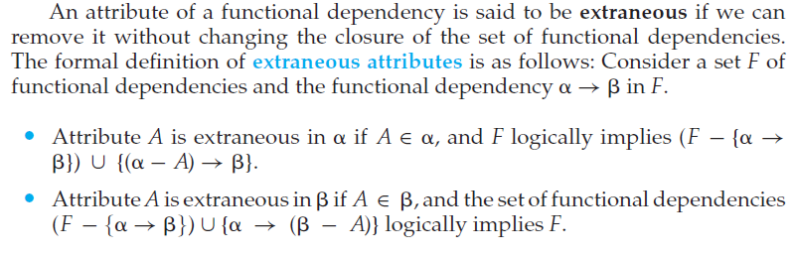
For example, suppose we have the functional dependencies
AB → C and
A→C in F.
Then, B is extraneous in AB →C.
As another example, suppose we
have the functional dependencies
AB →CD and A→C in F.
Then C would be
extraneous in the right-hand side of AB →CD

Slide 28
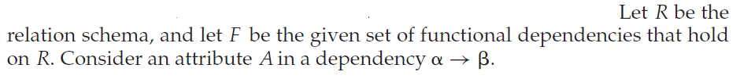
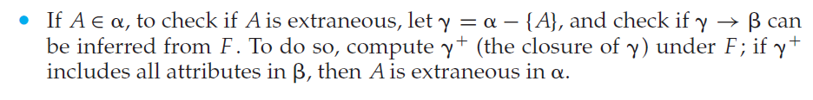
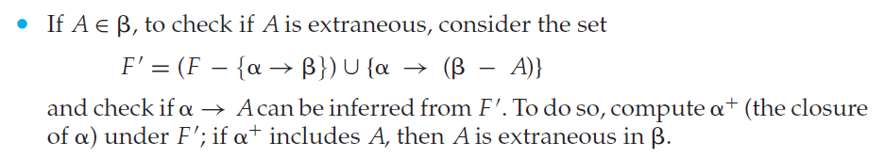

Slide 29
Extraneous attribute in L H S of an fd.
For example, suppose we have the functional dependencies
AB → C and
A→C in F.
F = {(AB→C), (A→C)}
Then, B is extraneous in AB →C.
α = AB
β = C
F¹ = (F – (AB→C)) U ((AB-B)→ C)
F¹ = {A→C}
γ = α – {A}
= AB – B
= A
Find γ+, ie., A+. A+={A,C}. A+ includes C.
So B in AB→C is extraneous.

Slide 30
Extraneous attribute in R H S of an fd.
F = {(AB →CD),(A→C)}.
C is extraneous in AB →CD
α = AB
β = CD
F¹ = (F – {AB →CD}) υ {AB→ (CD-C)}.
F¹= {(AB→D),(A→C)}
Find α+ (using F¹)
(AB)+ = {ABDC}
(AB)+ includes C
C is extraneous in AB →CD

Slide 31
Extraneous attribute in R H S of an fd.
F = {(AB →CD),(A→E), (E→C)}.
C is extraneous in AB →CD
α = AB
β = CD
F¹= {(AB→D),(A→E),(E→C)}
Find α+ (using F¹)
(AB)+ = {ABDEC}
(AB)+ includes C
C is extraneous in AB →CD

Slide 32
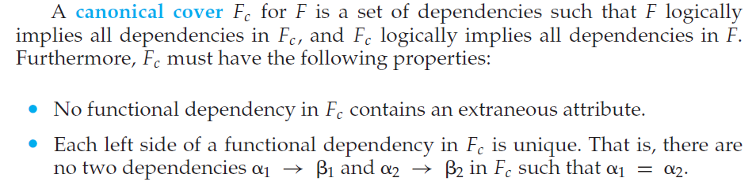
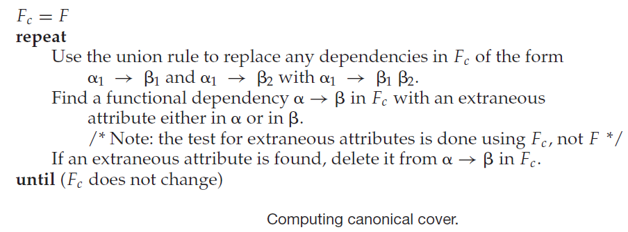

Slide 33
Consider r(R), with R = (A,B,C).
F = {A→BC, B→C, A→B, AB→ C}
Find Fc.
(1) There are 2 fds with A in the LHS : A→ BC and A→ B
Apply Union rule: A→ BC
Fc = {A→BC, B→C, AB→ C}
(2) A in AB→C is extraneous. Because B+={BC} and there exists B→C
Fc = {A→BC, B→C}
(3) C is extraneous in A→BC. Because Fc¹={A→B, B→C.} and A+={A,B,C} includes C.
So, Fc = {A→B, B→C}

Slide 34
For a given F, if a entire fd is extraneous that fd can be removed.
Finally the Fc should not have any extraneous attribute (in LHS and RHS)
For a fd with one attribute in the RHS and that also extraneous then that fd can be removed from the F.
In a F, for a fd with more than one attribute in the RHS, if all the attributes in the RHS are extraneous then multiple Fc possible.
Eg. F = {A→BC, B→AC, C→AB}
If we test A→BC, both B and C are extraneous. But we don’t delete both together but one by one. So if B is deleted first we get different Fc than if we delete C first.

Slide 35
F = {A→BC, B→AC, C→AB}
Take A → BC, Test for B.
F1={A→C, B→AC, C→AB}
Find A+. A+={ACB}
A+ includes B, so B is extraneous in A→BC
F = {A→BC, B→AC, C→AB}
Take A → BC, Test for C
F1={A→B, B→AC, C→AB}
Find A+. A+={ABC}
A+ includes C, so B is extraneous in A→BC
If B is deleted first
Fc={A→C, B→AC, C→AB}
If C is deleted first
Fc={A→B, B→AC, C→AB}

Slide 36

F¹={A→B, B→AC, C→AB}
C→AB
B→AC
Test for A
F1 = {A→B, B→C, C→AB}
Find B+. B+={B,C,A}
B+ has A
A is extraneous
So Fc ={A→B, B→C, C→AB}
Test for C
F1= {A→B, B→A, C→AB}
Find B+. B+= {B, A}
B+ doest have C.
C is not extraneous.
Test for A
Test for B

Slide 37
Next
Lossless Decomposition
Dependency Preservation

